Slide 1
Orpheus Descent
Toe Breakers
A Toe Breaking Experience

Slide 2
Format
2D Platformer
Necrodancer in 2D
BGM classical music in electro form

Slide 3
Story
Orpheus

Slide 4
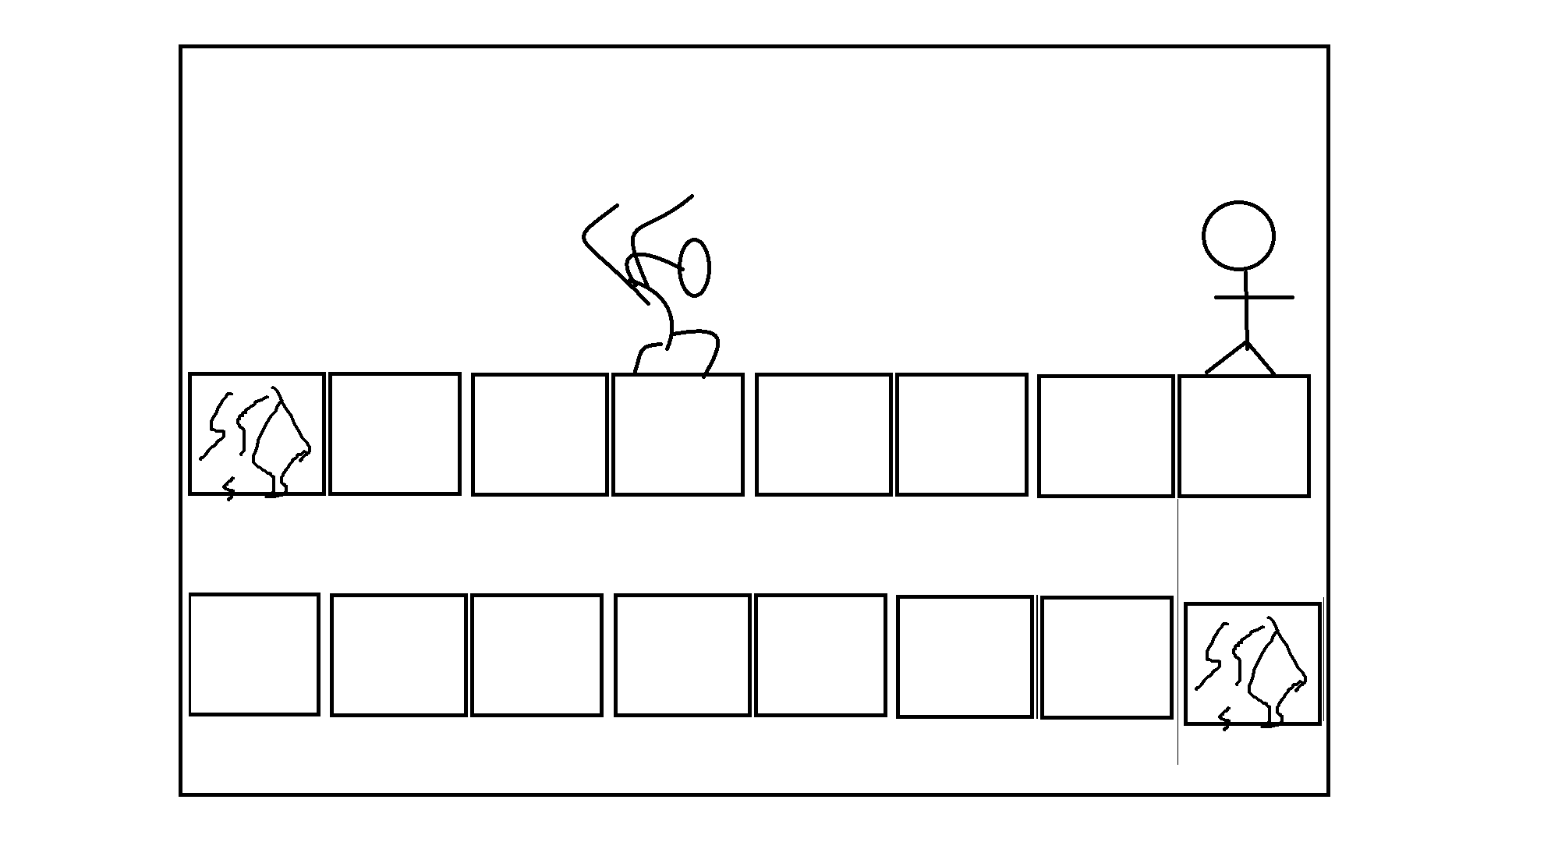
Game Method

Slide 5
Game Method
Step on the fissure block to continue
Slay monsters to gain gold
Different type of blocks and monsters

Slide 6
Floors (change name, such as verse.. Level.. Area.. Etc…)
1~9th floor has 1min music and area accordingly
Every 10th floor is boss area 3~5 min
11th floor is the shop and save room
Basic 4 missed step equals to death (2 coins, front and back)

Slide 7
Music
Classical music about Orpheus
All in electro or some other form

Slide 8
Bosses
From Greek mythology
F10
F20
F30
F40
Fake boss: Hades
Real boss: Persephone

